Slide 1
Thinking about
Your Future In
Education or Training
In 2021-22

Slide 2
Who is presenting this evening?
Ed Hawkings
Assistant Headteacher who manages the careers advice at Sweyne Park
Steve Cooper
Independent careers advisor who works closely with the
school, employed by Connexions

Slide 3
The purposes of this evening:
understand possible pathways for Post-16 education & training
have tools/plans for exploring next steps and even Post-18
develop thinking, which is aspirational and realistic for the next 1-2 years and beyond
Notes:
3

Slide 5
On average a person in the UK changes job 12 times in their working life, with most changes being in the 18-24 age group (5.5 jobs).

Slide 7
The FUTURE of jobs
Disruption – 1 in 5 jobs will likely decline
Important skills will include the ability to:
teach other people
solve problems
read social situations
analyse systems
develop unusual or clever ideas about new topics
be a life-long learner

Slide 8
The FUTURE of jobs – key factors
Automation and Artificial Intelligence (AI)
Sustainability and the Green Economy (rather than the polluting economy)
Global Labour Market
Multi-generational (4?)

Slide 9
Future jobs 2030?

Slide 10
Future jobs 2030?

Slide 11
Future jobs 2030?

Slide 12
Careers where do I start?
What am I like as a person?
What do I enjoy?
What are my interests?
What skills/abilities do I have?
What lifestyle do I want?
What makes me happy/ambitions?
Who can help me?
Notes:
12

Slide 13
Why do qualifications matter?

Slide 14
What does having a degree do?

Slide 15
How can qualifications affect future wages?

Slide 16
Why are English & Maths so important?
Until 18th birthday, need to continue studying for English Language and Maths UNTIL achieve GCSE/iGCSE grade 4 or equivalent
Functional skills level 2
Grades in English Language/Literature & Maths affect what courses you can do Post-16

Slide 17
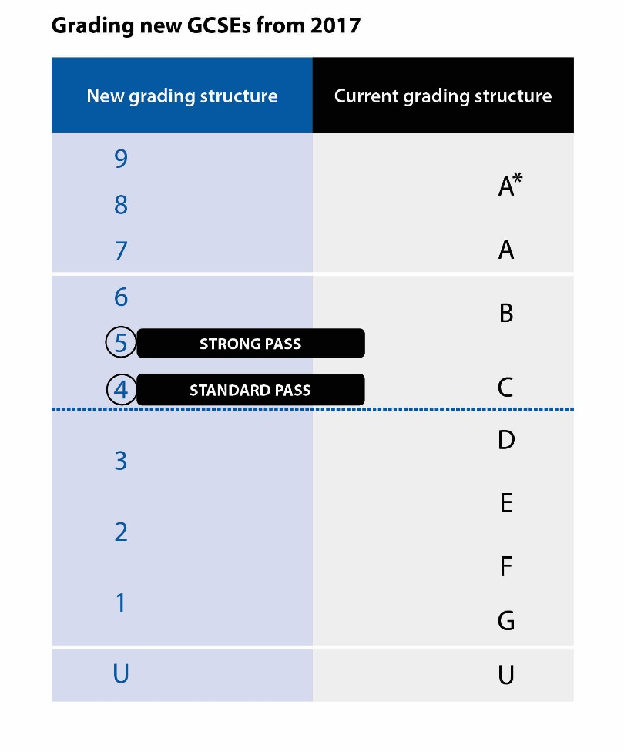
What does the new GCSE 1-9 system mean?

Slide 18
Post 16 Options
Raising Participation
Age (RPA)
Further Education
A Levels
Diplomas e.g.
BTEC, UAL
Training
Apprenticeships
Traineeships
Part time Education
or Training if:
Employed
Self-Employed
Volunteering

Slide 19
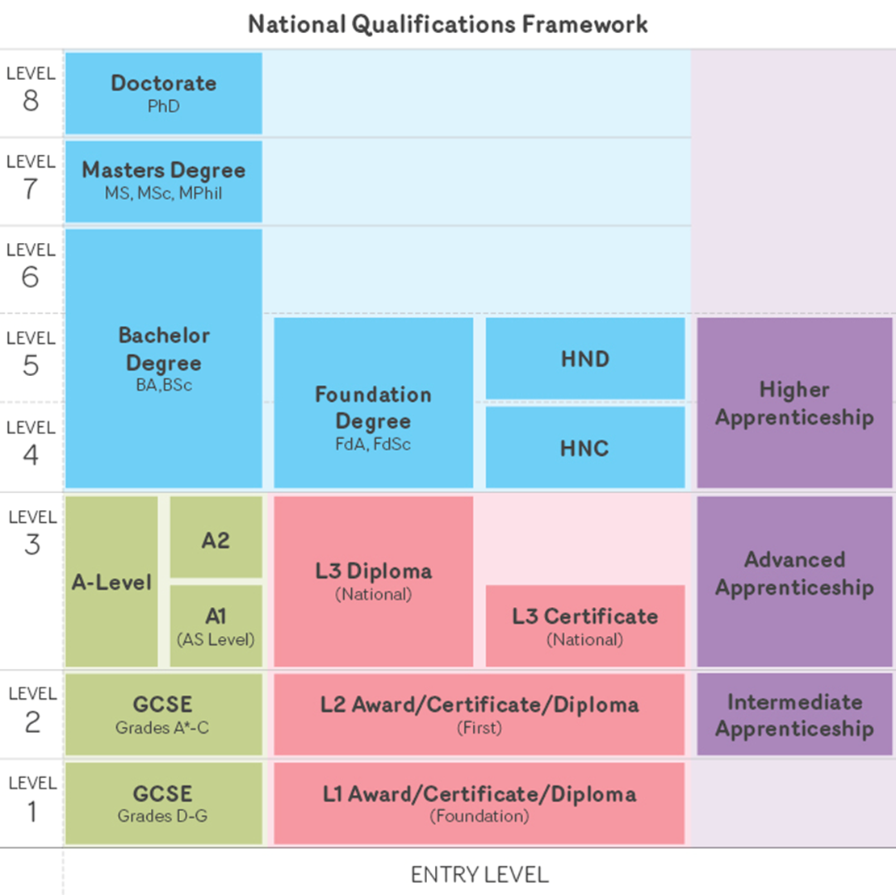
Degree Apprenticeship
Higher Apprenticeship
Level 3
Ext Diploma,
Nat Diploma,
Ext Certificate etc.
A-Level
T-Level
Level 2 Diploma
First Diploma
Grade 4-9
Level 1 Diploma
Foundation
Grade 1-3

Slide 20
Destinations – where do I start?
How far am I prepared to travel?
What providers are there?
What courses am I interested in?
What provider will suit me?
Visits & websites
Ofsted reports
Course completion/outcomes
People going there
Progression/next steps
English/Maths
Employability
Notes:
20

Slide 21
What are popular A levels? (Also known as GCEs)
Art & Design
Business Studies
Dance
Drama & Theatre Studies
Economics
English Language
English Literature
French
Geography
Government & Politics
German
History
Applied Science
Biology
Chemistry
Geology
Maths
Further Maths
Physics
Computing
Music
Mandarin
PE
Philosophy
Product design: Graphics
Product design: Textiles
Psychology
Consider University courses
Facilitating subjects
Where to study
3 & 1
Essay writing subjects
Higher Apprenticeships

Slide 22
What are the entry requirements to do A levels?
AS & A2 Levels
GCSE grades of at least a 6 (B) in the subjects being studied, as well as at least a 4-5 (C) in English Language/Literature and Maths
Main route into university, especially Russell Group (24 top universities)

Slide 23
Examples of BTECs/Diplomas & other professional qualifications? (Various levels and sized qualifications)
Animal management
Applied science
Art & design
Beauty Therapy
Bricklaying
Business
Carpentry & joinery
Children’s care learning & development
Engineering
Hairdressing
Health & social care
Horse management
Hospitality
Professional cookery
IT
Media
Music
Music technology
Performing arts
Photography
Public services
Sport & exercise sciences
Vehicle maintenance & repair

Slide 24
What are BTECs/Diplomas/Professional qualifications?
Assessed through combinations of internal and external units
Level 3 can be a route to university, with A levels or D*/D/M grade combinations
Entry requirements depend on level, are specific to course, & college/school studied at
Entry Level: Ability to work at Entry Level 1
Level 1: Ability to work at Level 1
Level 2: Two GCSE at 3+ (English and Maths at 3+)
Level 3: 4/5 GCSEs at 4+(C+) inc. English & Maths at 4+

Slide 25
Diplomas (including BTECs) beware the names, levels and sizes
Level 1/2/3
GCSE 3-1 (D-G), GCSE 9-4 (A*-C), A level
Extended Certificate/Foundation Diploma/
Diploma/Extended Diploma
L2 GLH or guided learning hours – multiples of 120GLH (where 1 equivalent to a GCSE is 120GLH)
L3 GLH or guided learning hours – multiples of 360GLH (where 1 equivalent to an A level is 360GLH)
e.g. Engineering level 2 Extended Certificate
Engineering level 3 Diploma or Extended Diploma

Slide 26
Foundation Learning – Entry Level / Level 1
Foundation Learning courses are one-year programmes that can help you to progress onto a Level 2 BTEC Diploma or Apprenticeship. It includes a vocational qualification, Functional Skills in English, Maths & ICT, and Personal & Social Development.

Slide 27
Apprenticeships – popular types…
Animal care
Catering
Childcare
Construction
Engineering
Hairdressing
Horticulture
Mechanics
Office work
Retail
Veterinary nursing

Slide 28
Apprenticeships in outline…..
By 2020 the government want 3 million more apprentices
Ready for work
Earn & learn (Minimum £3.90 per hour in 1st year)
Job training & college placements
Functional skills
Earliest start date June 30th 2020
Apprenticeships website

Slide 29
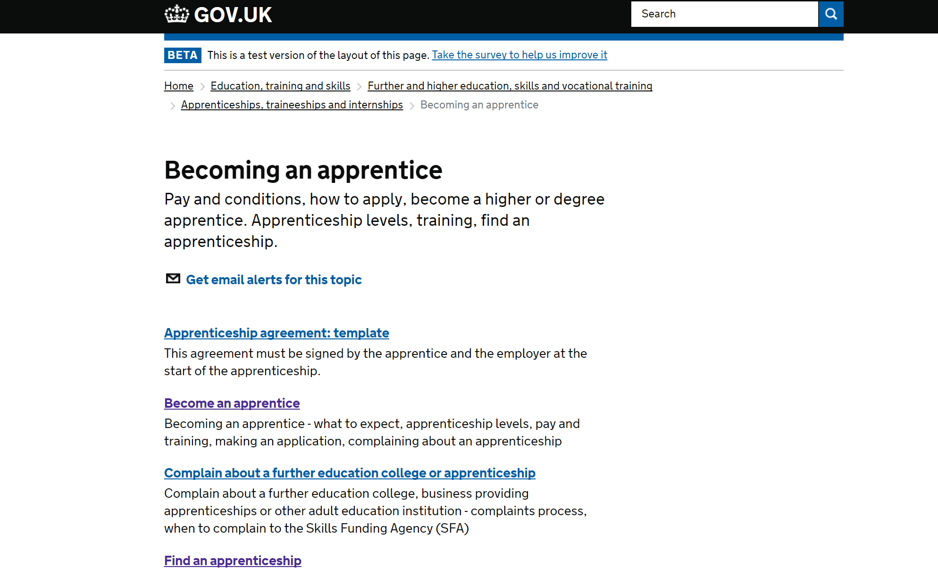
Apprenticeships - Gov.UK website

Slide 30
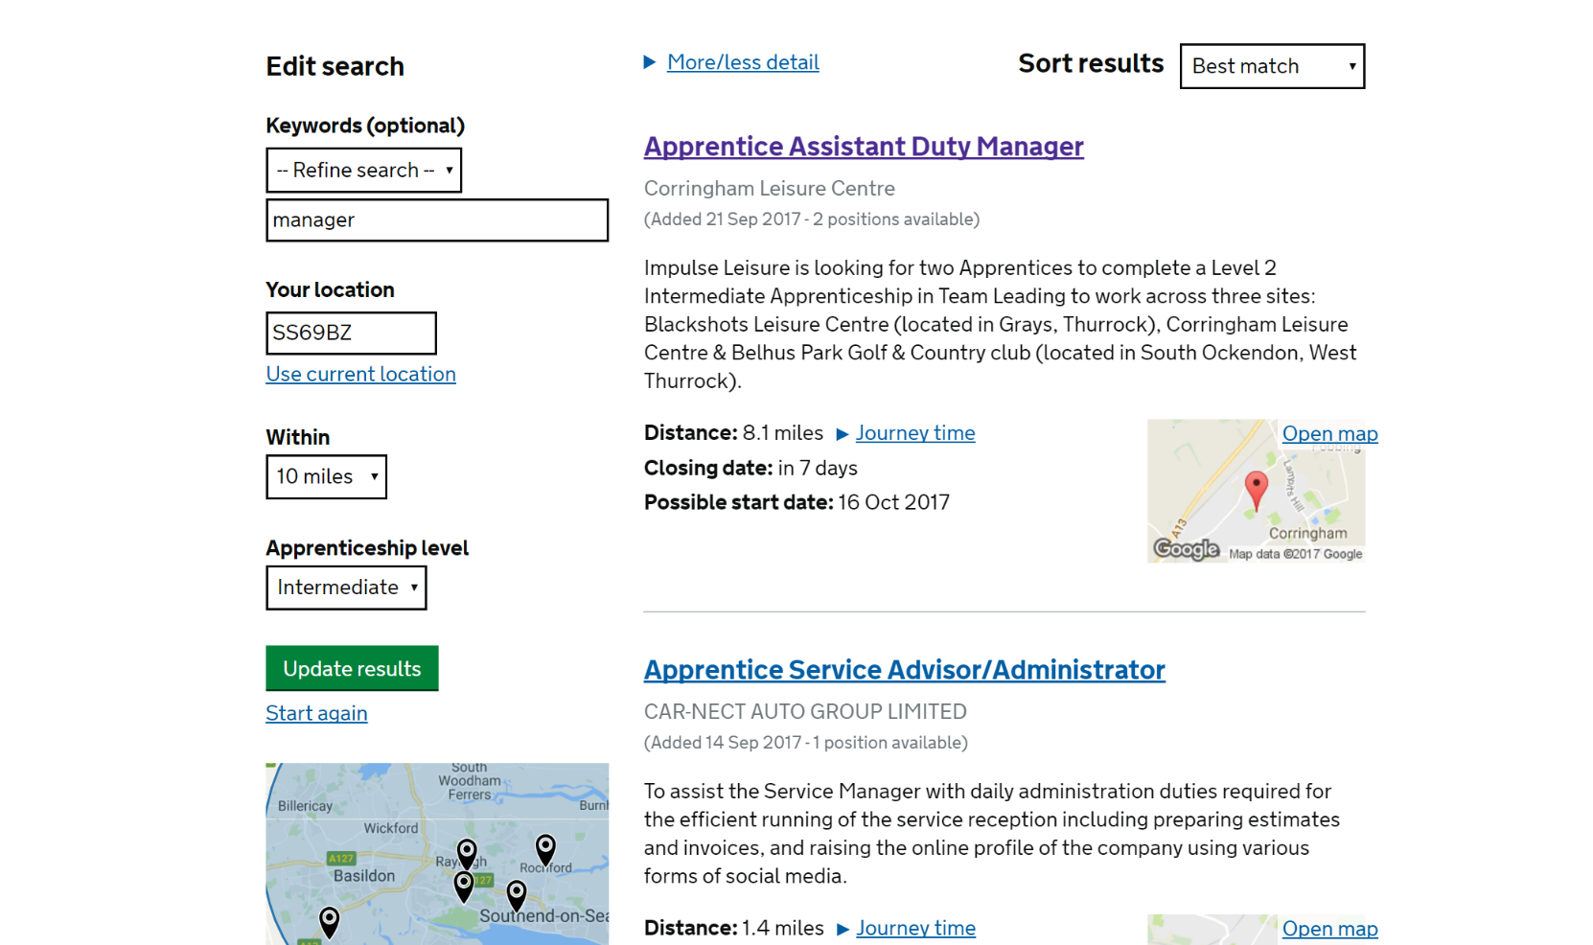
Find an apprenticeship

Slide 31
Apprenticeship standards

Slide 32
Apprenticeship standards

Slide 33
Next steps
What are you going to do next (as a family) about your Post-16 plans?

Slide 34
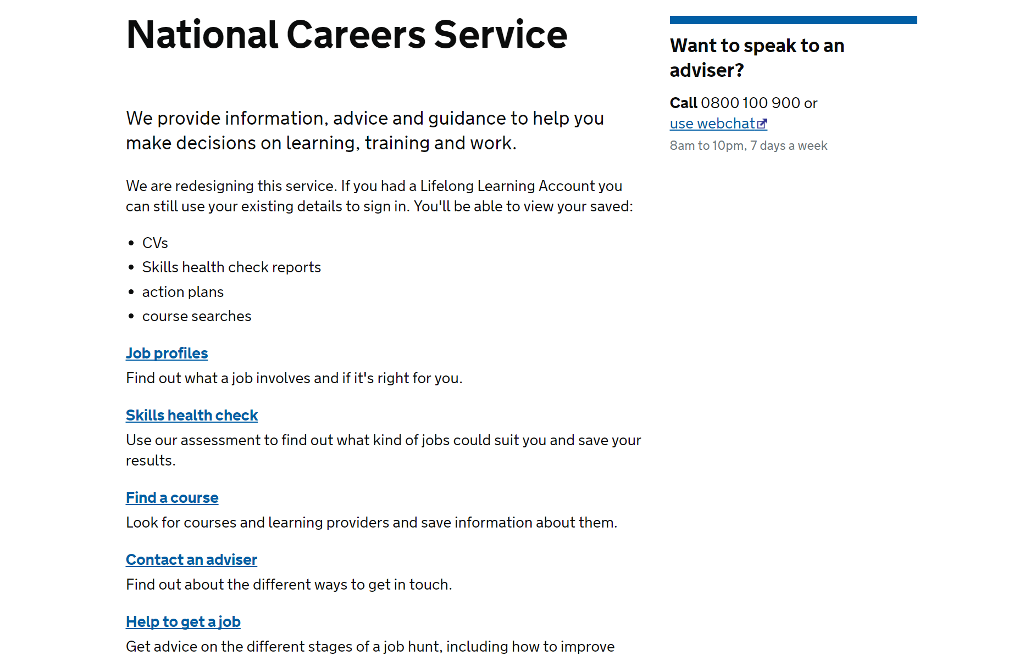
National Careers Service website

Slide 35
Further help
If you are ready to have a careers meeting
with Steve Cooper pass your name to him
tonight or Mr Hawkings at school.

Slide 36
Some helpful websites
National Careers Service https://nationalcareersservice.direct.gov.uk/Pages/Home.aspx
Apprenticeships https://www.gov.uk/apprenticeships-guide/overview
Indeed https://www.indeed.co.uk/Apprenticeships-jobs-in-Rayleigh
NHS https://www.healthcareers.nhs.uk/career-planning/study-and-training/apprenticeships-traineeships-and-cadet-schemes/
UCAS https://www.ucas.com
Kudos https://kudos.cascaid.co.uk/#/ each person has their own login (obtained from E Hawkings)
iCould http://icould.com
Sweyne Park http://sweynepark.com/html/learning/careers/index.html

Slide 37
Key Points
There is a course out there for everyone.
Progression onto higher qualifications is possible via any route.
4+ in English Language and Maths is very important – increasing choice and rate of progression.
You can all be successful, invest in your futures now, by planning and trying as hard as possible at school.

Slide 38
Finally tips from us…..
Get going right now, (do NOT panic) plan the Open Evenings you are going to attend.
Discuss with advisors, teachers, parents, family, friends……
Get your questions sorted out before you go to an Open Evening or Apprenticeship evening – remember your future relies on you making the right decisions about where to go and what to study.
You need to have thought about how likely it is you achieve your first choice and consider back-up plans.
Be aspirational and realistic – LOOK INTO THE FUTURE, but remember you will change career pathways throughout your life.

