Slide 1
Further Education Evening
Overview
Why A Levels?
How do A Levels work?
Applying to Sixth Form
4. Which A Levels?
5. Are A Levels worth it?

Slide 2
Further Education Evening
1. Why A Levels?
They are highly valued by employers, universities and colleges
They have been used as a benchmark to judge student ability for over 60 years
They remain the ‘gold standard’ of Level 3 qualifications
They provide an opportunity to think deeply about your subject, satisfy intellectual curiosity, and engage with like-minded students

Slide 3
Further Education Evening
2. How do A Levels work?
A Levels have changed since 2014:
- All subjects now involve terminal assessment, i.e. all exams after two years
- The AS Level still exists, but as a standalone qualification
Assessment by exam has increased. Coursework now accounts for a maximum of 20% in each subject. (There are some exceptions to this, e.g. practical subjects such as Art, Music and Product Design.)
The practical component of Science A Levels (Biology, Chemistry and Physics) no longer counts towards the final grade. There is a separate Pass/Fail judgement.

Slide 4
Further Education Evening
2. How do A Levels work?
Some qualifications have not been reformed. Subjects which have disappeared from the A Level curriculum include Creative Writing and IT.
The standard route through the Sixth Form is now three A Levels rather than four, with the EPQ taking the place of the discontinued fourth subject at AS Level.

Slide 5
Further Education Evening
2. How do A Levels work?
Sweyne Park Sixth Form no longer offers exam entry at AS Level. This is line with the county and national trend.
Most departments felt that preparation for the AS exam impinged upon the time required to prepare for full A Level.
There is not enough evidence to suggest that being entered for the AS Level improves either attainment or progress outcomes at A Level.

Slide 6
Further Education Evening
3. Applying to Sixth Form
Almost all Sixth Forms have an entry threshold
All students should aim for Grade 5 and above in all their subjects. We will provide further details on Sixth Form Open Evening.
Most schools also have individual subject entry requirements
At Sweyne Park, we require Grade 7 to study Maths and Science A Levels, and Grade 6 to study English Language and/or English Literature and Modern Languages. (Some other subjects also have minimum entry thresholds.)

Slide 7
Further Education Evening
3. Applying to Sixth Form
The application window for the Sweyne Park Sixth Form opens on Thursday 11 November, immediately after Open Evening.
The application deadline is Monday 13 December.
All applicants to the Sweyne Park Sixth Form will be given a guidance meeting with a member of the Sixth Form Leadership Team.
The Sweyne Park Sixth Form Induction programme runs on 12-13 July 2021. These dates have been chosen in order to allow you to attend other induction programmes.

Slide 8
Further Education Evening
4. Which A Levels?
How should I choose my A Level subjects?
Choose a subject you have enjoyed in the past
Choose a subject for which you have a genuine intellectual curiosity
Choose a subject you need for your chosen university course or career path
Choose a subject you think will suit your strengths

Slide 9
Further Education Evening
4. Which A Levels?
How should I NOT choose my A Level subjects?
Do not choose a subject on the basis of which teacher(s) you think you will have.
Do not choose a subject based on friendship groups.
Do not choose a subject you think ‘will be good for you’.

Slide 10
Further Education Evening
4. Which A Levels?
Other things to consider…
All subjects are considerably more difficult at A Level than they are at GCSE. A Grade 4 at GCSE (equivalent to the old Grade C) does not necessarily translate into a Grade C at A Level.
Do your research. There are many misconceptions about subjects required for courses and careers.
Do not take an uninformed risk.

Slide 11
Further Education Evening
4. Which A Levels?
And most importantly…
✓ The final choice must be yours, and yours alone

Slide 12
Further Education Evening
4. Which A Levels?
Which subjects will give me the greatest number of options?
The Russell Group facilitating subjects are the most commonly sought:
Maths and Further Maths English Literature
Chemistry Geography
Biology History and/or Politics
Physics Modern Languages

Slide 13
Further Education Evening
4. Which A Levels?
Which subjects are prerequisites for university courses?
Course | Essential subjects | Useful subjects
Accountancy | Maths* | Maths, Business Studies, Economics
Architecture | None | Art, Maths, DT, Physics
Biochemistry | Chemistry, 1 from Maths/Biol/Phys | Maths, Biology, Physics
Chemical Engineering | Chemistry, Maths | Physics
Chemistry | Chemistry, 1 from Maths/Biol/Phys | Maths, Biology, Physics
Computer Science | Maths* | Computing, Further Maths
Dentistry | Chemistry, Biology*, Maths* | Physics
Economics | Maths* | Economics, Business Studies

Slide 14
Further Education Evening
4. Which A Levels?
Which subjects are prerequisites for university courses?
Course | Essential subjects | Useful subjects
Engineering | Maths, Physics | Further Maths, Computing
Geography | Geography*, 1 from Biol/Chem/Phys* | Biology, Chemistry, Physics
Law | English* | History, Politics
Maths | Maths, Further Maths* | Further Maths, Physics
Medicine | Chemistry, Biology*, Maths* | Maths, Physics
Modern Languages | Varies by university
Nursing and Midwifery | Biology | Chemistry, Physics
Pharmacy | Chemistry, 1 from Biol/Maths/Phys | Biology, Maths, Physics

Slide 15
Further Education Evening
4. Which A Levels?
Which subjects are prerequisites for university courses?
Course | Essential subjects | Useful subjects
Physics | Maths, Physics, Further Maths* | Further Maths
Physiotherapy | Biology, 1 from Maths/Chem/Phys* | Chem, Maths, Physics, Psychology
Psychology | 1 from Biol/Chem/Maths/Phys* | Biol, Chem, Maths, Phys, Psychology
Sports Science | 1 from Biol/Chem/Maths/Phys* | Biol, Chem, Maths, Physics, PE
Teacher Training | At least 2 facilitating subjects
Veterinary Science | Chemistry, Biology, Maths or Physics | Maths, Physics, Further Maths

Slide 16
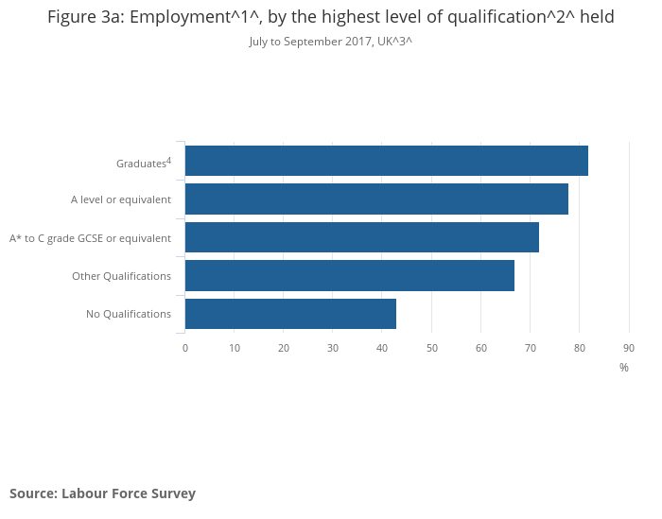
Further Education Evening
5. Are A Levels worth it?
Graduates are more likely to be employed…

Slide 17
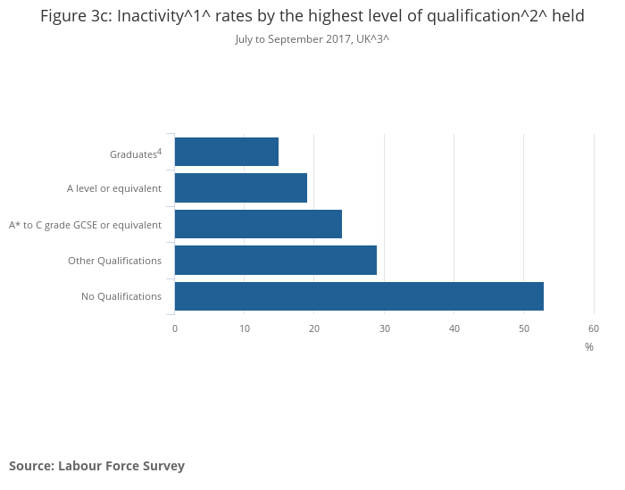
Further Education Evening
5. Are A Levels worth it?
…less likely to be economically inactive…

Slide 18
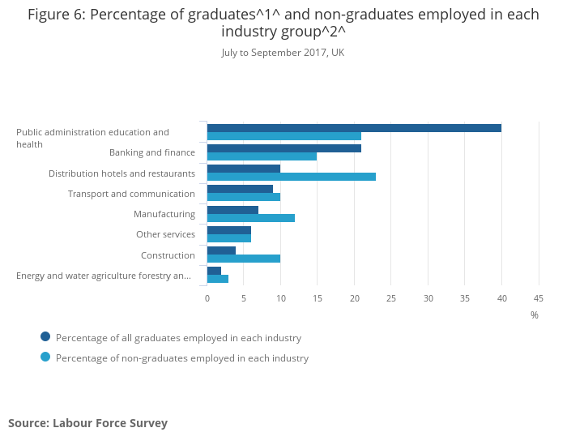
Further Education Evening
5. Are A Levels worth it?
…and more likely to be employed in typically higher paid industries.

Slide 19
Further Education Evening
And finally…
Know what you want to study? – Research the entry requirements
Not sure yet? – Keep your options open!
GCSE results matter
Aim for a balance
Make sure you know why you are choosing your subjects

