Slide 1
What is the ASK programme?
Notes:
Welcome and introductions
Today’s presentation is to inform you about the Apprenticeship Support & Knowledge for schools project (ASK for short)
The ASK project sits within the National Apprenticeship Service, funded by the Department for Education It launched in September 2015 as a pilot. It has been so successful that we then secured funding again for 2016/17 and this year 17/18. We are now in the process of contracting for the next three years.
Through this National Apprenticeship Service project, we are successfully establishing relationships with thousands of schools across England to help to change the way that apprenticeships are perceived by students, teachers and parents.
The presentation today will last approximately 20 minutes and we will then have time for questions.

Slide 2
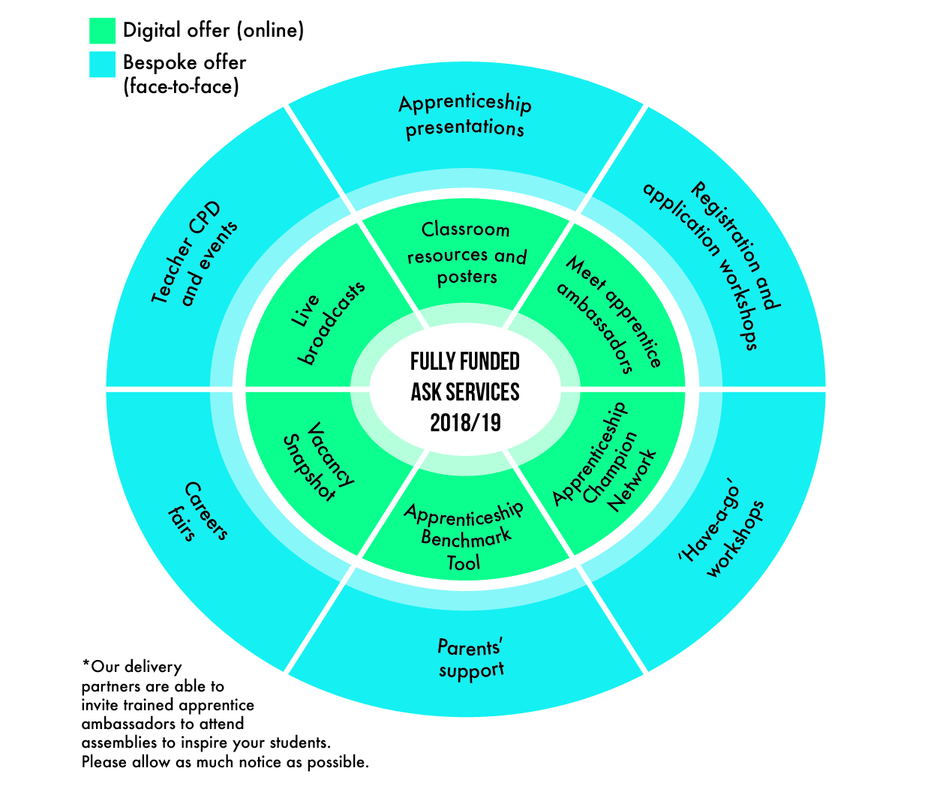
The ASK offer for 2018/19 www.amazingapprenticeships.com
Notes:
The ASK programme offers a wide range of support for your students and staff.
This image shows how it is split into a digital offer (which is unlimited for all to access) and a bespoke offer which is tailored to the needs of the school or college that we are working with.
Step 1 is to book a planning meeting as soon as possible so that our expert delivery partners can discuss your needs and plan in the most appropriate support for you.

Slide 3
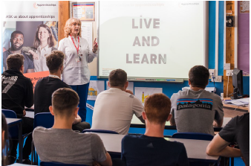
The bespoke offer to schools
Awareness presentations including apprentice ambassadors
Registration & application workshops
Have-a-go workshops
Events & workshops for parents
Careers fair attendance
Teacher CPD sessions
Notes:
The ASK programme offers every educational establishment in England with students in years 10 – 13 access to a
fully funded, bespoke apprenticeship support package to transform apprenticeship awareness activities so that students, parents, teachers and governors can be informed about the wonderful opportunities that apprenticeships can offer.
The range of workshops and activities available is vast.
We can support students, teachers and parents.

Slide 4
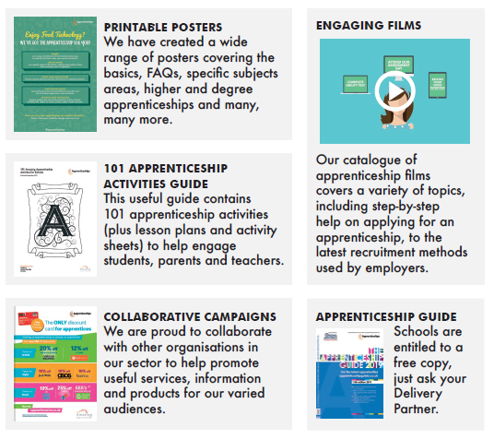
Resources
Notes:
In addition to the bespoke offer, the Amazing Apprenticeships website offers schools and colleges a wide range of exciting resources
You can download posters, activity guides, films, case studies and much more.

Slide 5
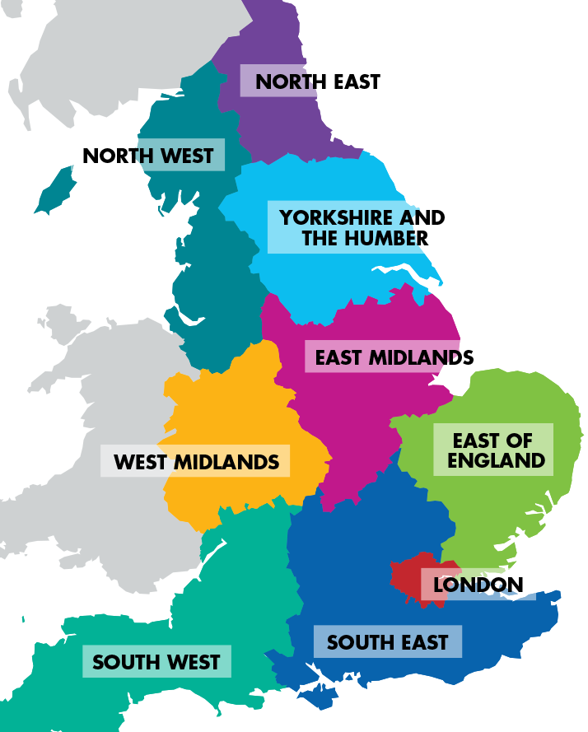
Young Apprentice Ambassadors Network
The main purpose of the ambassadors role is to promote apprenticeships and inspire other young people by describing their experience.
Notes:
Through the Young Apprentice Ambassador Network we have hundreds of brilliant apprentices who have received
training to speak publicly about their apprenticeship experience. Schools and colleges can request a talk by completing the form on the Amazing Apprenticeships website. We will then work to find you a suitable apprentice to come along and meet your students.

Slide 6
Apprenticeship live broadcasts
Notes:
Our exciting range of live broadcasts showcase some of the most inspiring apprenticeship opportunities available and feature live interviews with the
employer and their apprentices. Watch the live broadcasts with groups of students to have your questions answered live on air.
Alternatively, you can watch on catch-up at a time to suit you.

Slide 7
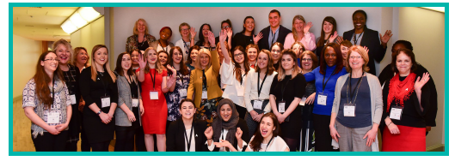
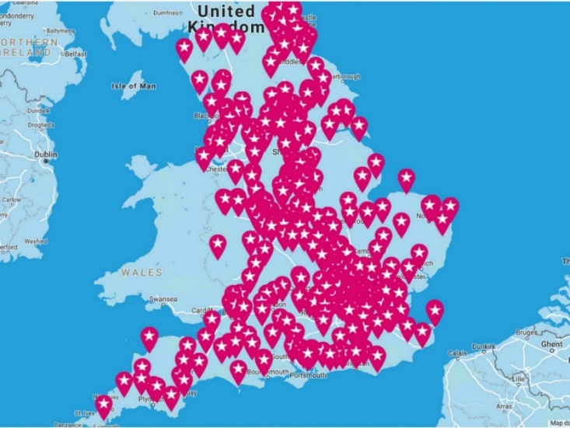
Apprenticeship Champion Network
All Apprenticeship Champions receive
Additional resources
Poster pack for your school/college
Sharing of best practice
Monthly newsletter
Notes:
It is completely free of charge to sign up to the Apprenticeship Champions network.
Our Apprenticeship Champions Network already boasts 1000+ members from schools and colleges across England who are proudly championing apprenticeship options to their students, parents and colleagues.
We want to help you to do even more, so once you have joined we will provide you with:
A poster pack
A Champion Badge
The opportunity to network and share best practice
Monthly newsletter
What does it take to be a champion?
We simply ask that you are committed to promoting apprenticeships as a credible option to young people, parents and
colleagues – that’s all! You may even consider entering the National Apprenticeship Awards as Apprenticeship Champion of the year!

Slide 8
How to book support
Visit website
Complete form
Hold planning meeting
Get started
Notes:
Visit the Amazing Apprenticeships website www.amazingapprenticeships.com/request-support
Complete the ‘Request Support’ form
The Delivery Partner will contact you within 5 days
They will book in your planning meeting (telephone or face to face)

Slide 9
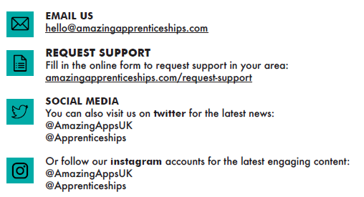
Contact us

